Slide 1
Measuring the Loss of Wealth
in Asheville
Group 4:
Xander Smead, Yicheng Wang, Daniel Rong, Zhaojie Yin, Anna Kafrune

Slide 2
Progress update
QGIS
Data Collection
Calculator

Slide 3
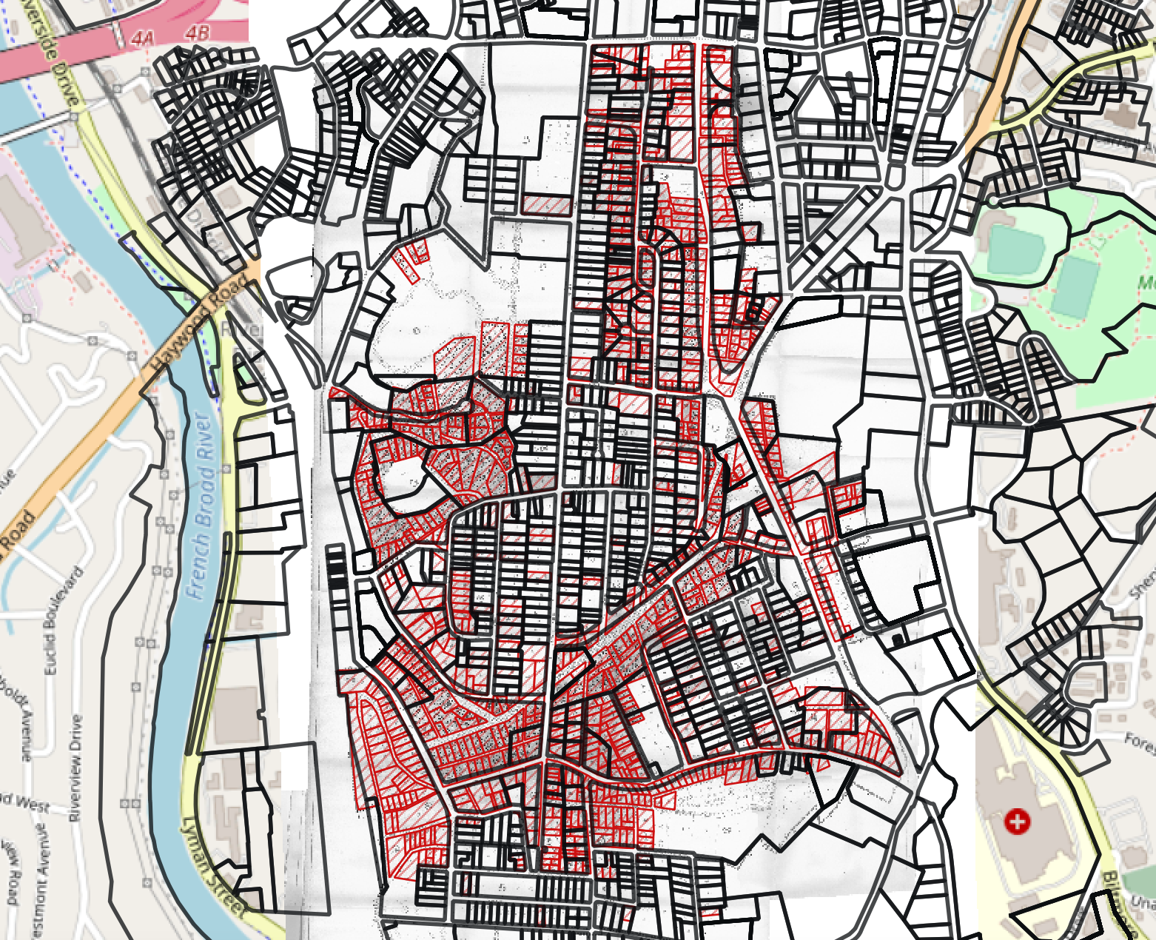
QGIS
This is the entire map containing the data we have for the whole city of Asheville. The yellow circle shows the part that we have been working with thus far.
Our methods could, potentially, be reproduced for the rest of the city to calculate the stolen wealth from every single property that was repossessed.

Slide 4
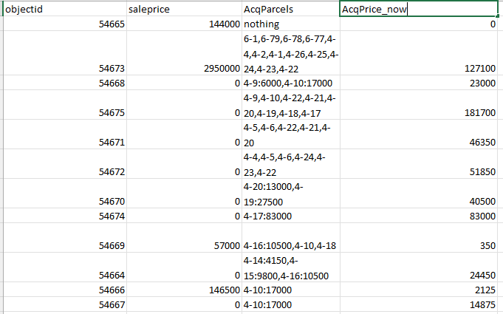
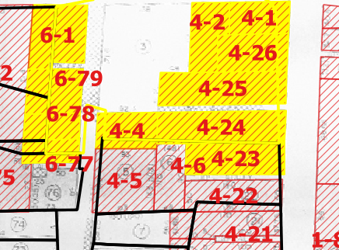
QGIS
First we focused on finding out how the parcels in the Asheville today match those from the 1960s and calculated the value of each parcel back to 1960.
For the overlapping parts, we calculate the approximate value based on the ratio of the area

Slide 5
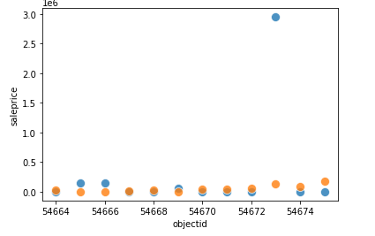
QGIS
This graph shows the change in the value of these properties between the 1960s and nowadays.
It does not accurately show the divide in property value gaps between time periods due to differences in parcel divisions (for example, The huge value gap of object 54673)

Slide 6
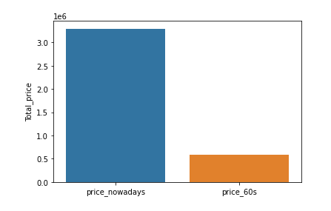
QGIS
This illustrates the change in value across block 4. We can see that the value appreciation is close to 4 times as much
Next Step in QGIS
Explore and refine more blocks of data to generate an ideal visualization

Slide 7
Data
Block number
Parcel number
Money
Appraisal year
Event id, parcel id, type id, person id
Response
Name
Land use
Street name

Slide 8
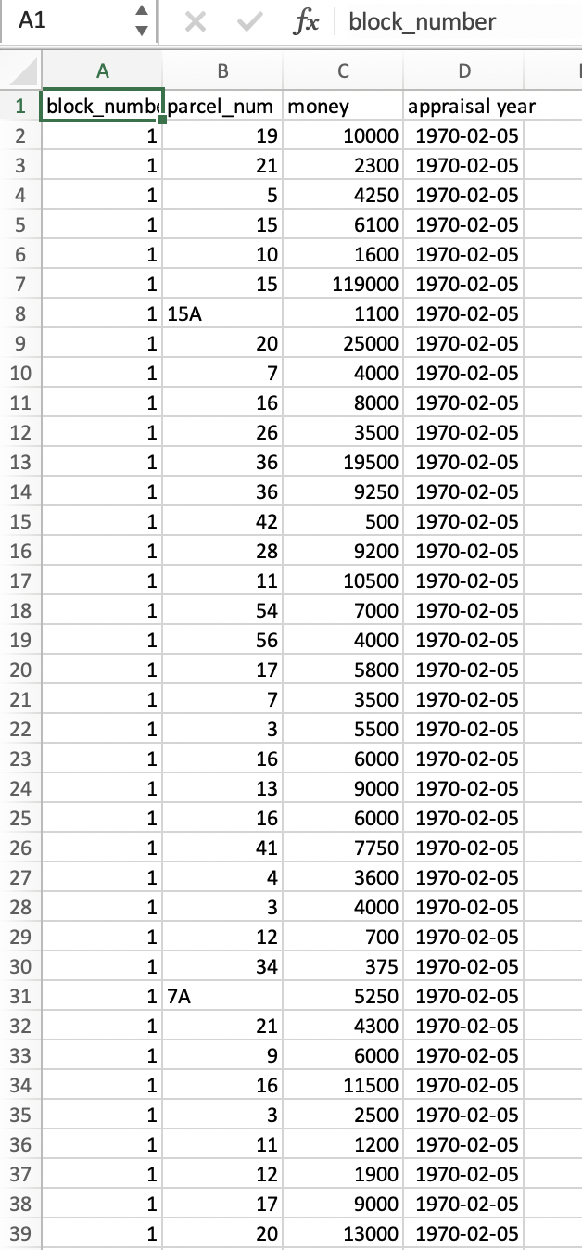
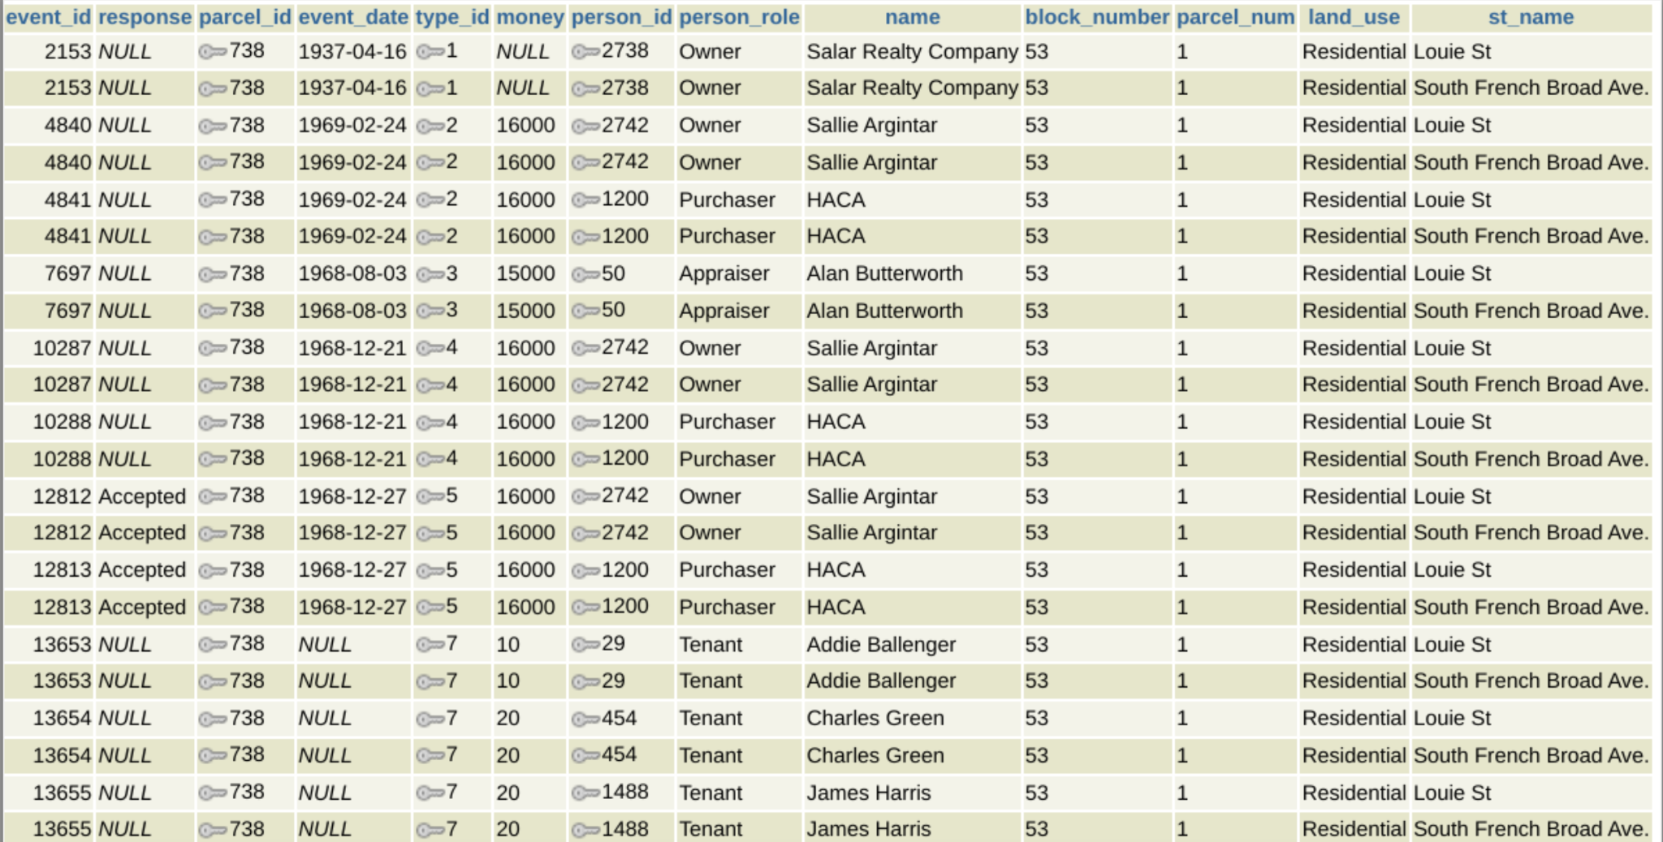
Examples of how we collect our data

Slide 9
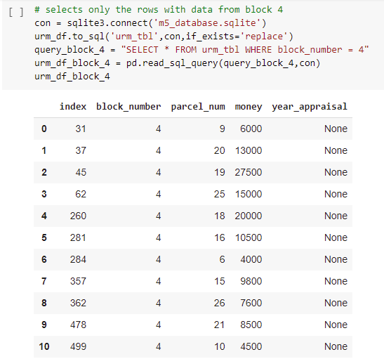
Calculator
Block 4 data

Slide 10
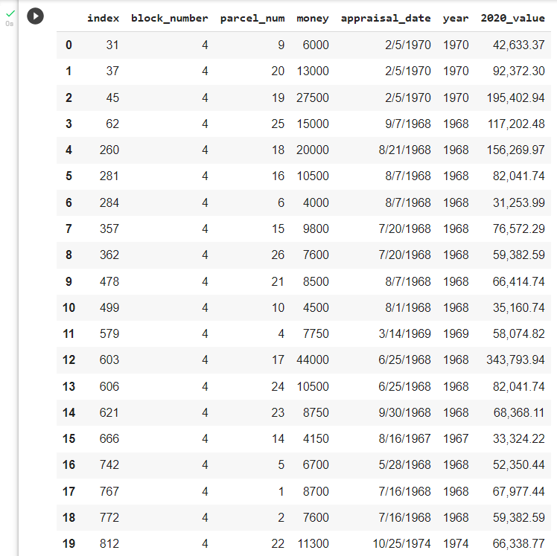
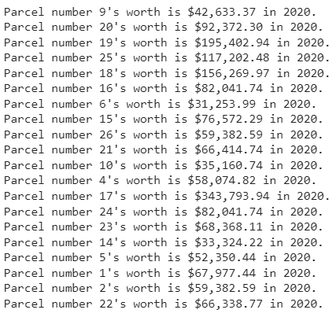
Calculator
Uses the yearly inflation in the US to calculate what the properties’ appraisal value would be in 2020.
Notes:
We used the yearly inflation in the US to calculate what the properties’ appraisal value that were determined since around 1960s would be in 2020. You can see the change from the appraisal value to the 2020’s value highlighted in the dataframe on the right.
This is the level 1 of the calculator, as we progress in our project, we will develop other calculators that find more precise results based on other available data we can find. For example, we can gather data on other appraisal points in the properties’ histories, such as when the government sold them to evaluate the extent of the change that had already happened in this shorter period of time.

Slide 11
To do
Comparing the differences between old and new parcel data
Assembling all our findings into a Google Colab notebook
Comparing how much Asheville payed
Look into other factors to better approximate property appreciation

